Slide 1
Datacenter as a Computer
Mosharaf Chowdhury

Slide 2
Why is One Machine Not Enough?
Too much data
Too little storage capacity
Not enough I/O bandwidth
Not enough computing capability

Slide 3
What’s in a Machine?
Interconnected compute and storage resources
Different bandwidth and latency constraints
Simplified diagram
Doesn’t include GPUs, accelerators such as FPGAs, faster networks such as RDMA, dedicated GPU interconnects such as NVlink, etc…
(100 GB/s)
Memory Bus
(2 GB/s)*
PCIe v4
(1 GB/s)
(600 MB/s)*
Ethernet
SATA
(50 - 100 MB/s)*
* Multiple channels

Slide 4
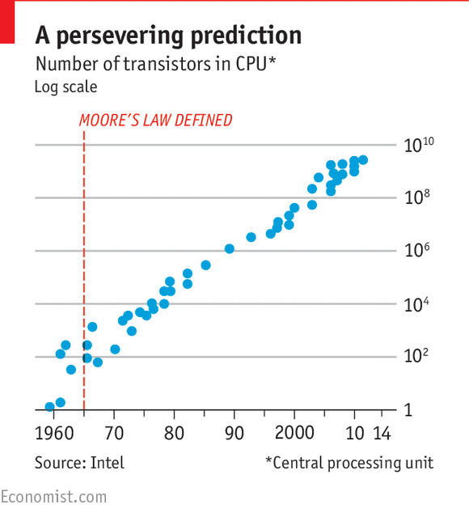
Scale Up: Make More Powerful Machines
Moore’s law
Stated 52 years ago by Intel founder Gordon Moore
Number of transistors on microchip double every 2 years
Today “closer to 2.5 years” – Intel CEO Brian Krzanich

Slide 5
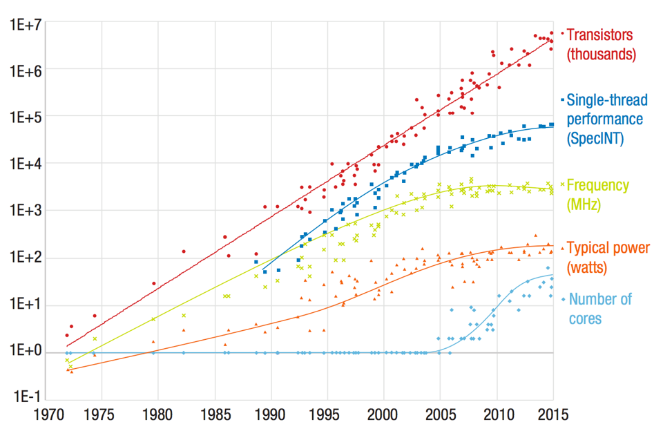
Dennard Scaling is the Problem
Suggested that power requirements are proportional to the area for transistors
Both voltage and current being proportional to length
Stated in 1974 by Robert H. Dennard (DRAM inventor)
Broken since 2005
“Adapting to Thrive in a New Economy of Memory Abundance,” Bresniker et al

Slide 6
Dennard Scaling is the Problem
Performance per-core is stalled
Number of cores is increasing
“Adapting to Thrive in a New Economy of Memory Abundance,” Bresniker et al

Slide 7
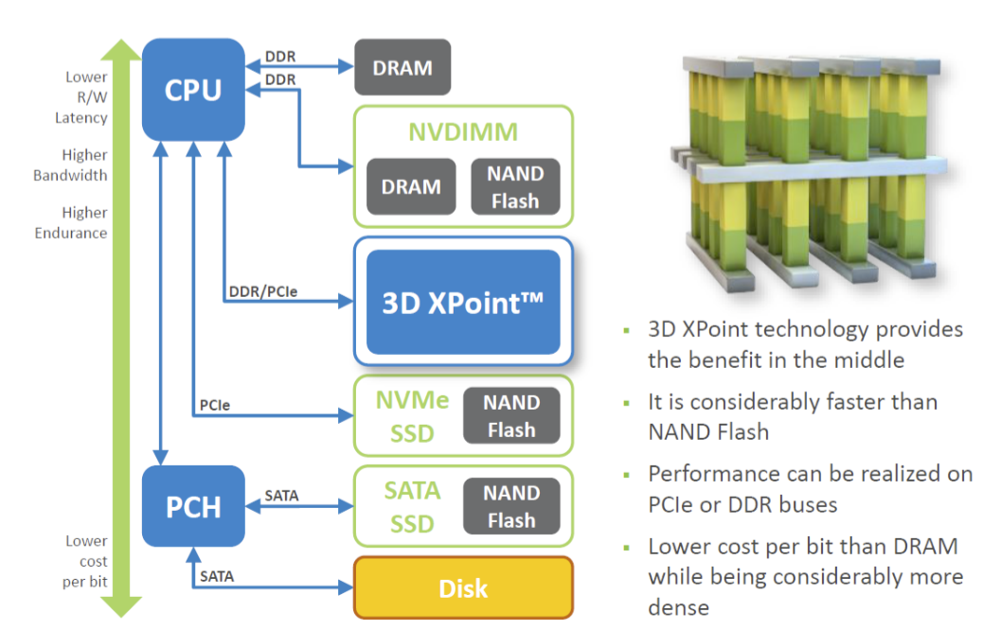
Storage Hierarchy
L1 cache
L2 cache
L3 cache
RAM
3D Xpoint
SSD
HDD
(https://www.youtube.com/watch?v=IWsjbqbkqh8)
Notes:
3D Xpoint
Few times slower reads than RAM
Writes are few times slower than reads
Non-volatile and byte-addressable
Interface is b/w-limited (6 GB/s)

Slide 8
Scaling Up is Unlikely to Help
Physical limits
Economical constraints
What about fault-tolerance?
How would you upgrade?
Anything else?

Slide 9
Scale Out: Warehouse-Scale Computers
Single organization
Homogeneity (to some extent)
Cost efficiency at scale
Multiplexing across applications and services
Rent it out!
Many concerns
Infrastructure
Networking
Storage
Software
Power/Energy
Failure/Recovery
…

Slide 10
Architectural Overview
Memory Bus
PCIe
Ethernet
SATA
Server
Server

Slide 11
Power, Energy, Modeling, Building,…
Many challenges
We’ll focus primarily on software infrastructure in this class

Slide 12
Datacenter Needs an Operating System
Datacenter is a collection of
CPU cores
Memory modules
SSDs and HDDs
All connected by an interconnect
A computer is a collection of
CPU cores
Memory modules
SSDs and HDDs
All connected by an interconnect

Slide 13
Some Differences
High-level of parallelism
Diversity of workload
Resource heterogeneity
Failure is the norm
Communication dictates performance

Slide 14
Three Categories of Software
Platform-level
Software firmware that are present in every machine
Cluster-level
Distributed systems to enable everything
Application-level
User-facing applications built on top

Slide 15
Common Techniques
Technique | Performance | Availability
Replication
Erasure coding
Sharding/partitioning
Load balancing
Health checks
Integrity checks
Compression
Eventual consistency
Centralized controller
Canaries
Redundant execution

Slide 16
Common Techniques
Technique | Performance | Availability
Replication | X | X
Erasure coding | X | X
Sharding/partitioning | X | X
Load balancing | X
Health checks |  | X
Integrity checks |  | X
Compression | X
Eventual consistency | X | X
Centralized controller | X
Canaries |  | X
Redundant execution | X

Slide 17
Datacenter Programming Models
Fault-tolerant, scalable, and easy access to all the distributed datacenter resources
Users submit jobs to these models w/o having to worry about low-level details
MapReduce
Grandfather of big data as we know today
Two-stage, disk-based, network-avoiding
Spark
Common substrate for diverse programming requirements
Many-stage, memory-first

Slide 18
Datacenter File Systems
Fault-tolerant, efficient access to data
GFS
Data resides with compute resources
Compute goes to data; hence, data locality
The game changer: centralization isn’t too bad!
FDS
Disaggregated storage (compute and storage are not collocated)
Relies on full bisection bandwidth networks

Slide 19
Datacenter “Operating Systems”
Fair and efficient distribution of resources among many competing programming models and jobs
Does the dirty work so that users won’t have to
Borg
Google’s cluster manager
Utilization-first allocator
Grand father of Kubernetes
Mesos / YARN
Started with a simple question – how to run different versions of Hadoop?
Fairness-first allocator

Slide 20
Resource Allocation and Scheduling
How do we divide the resources anyway?
DRF
Multi-resource max-min fairness
Two-level; implemented in Mesos and YARN
HUG: DRF + High utilization
Carbyne: DRF + Altruism over complex DAGs

Slide 21
Unavailability and Failure
In a 10000-server DC, with 10000-day MTBF machines, one machine will fail everyday on average
Build fault-tolerant software infrastructure and hide failure-handling complexity from application-level software as much as possible
Configuration is one of the largest sources of service disruption
Storage subsystems are the biggest sources of machine crashes
Tolerating/surviving from failures is different from hiding failures

Slide 22
What’s the most critical resource in a datacenter?
Why?

Slide 23
Break!

Slide 24
Datacenter Networks
Memory Bus
PCIe
Ethernet
SATA
Server
Server

Slide 25
Datacenter Networks
Traditional hierarchical topology
Expensive
Difficult to scale
High oversubscription
Smaller path diversity
…
Core
Agg.
Edge

Slide 26
Datacenter Networks
Clos topology
Cheaper
Easier to scale
NO/low oversubscription
Higher path diversity
…
Core
Agg.
Edge

Slide 27
Datacenter Topology: Clos aka Fat-tree
Multi-stage network
k pods, where each pod has two layers of k/2 switches
k/2 ports up and k/2 down
All links have the same b/w
At most k³/4 machines
Example
k = 4
16 machines

Slide 28
Datacenter applications
Common theme: parallelism
Applications decomposed into tasks
Running in parallel on different machines
Two common paradigms
Partition-Aggregate
Map-Reduce

Slide 29





Partition-Aggregate
Mosharaf
Top-level Aggregator
Mid-level Aggregators
Workers

Slide 30

Partition-Aggregate
Mosharaf
Top-level Aggregator
Mid-level Aggregators
Workers

Slide 31
Map-Reduce
Map Stage
Reduce Stage
The most popular software that follows this paradigm is Apache Spark

Slide 32
Datacenter Traffic
Core
North-South Traffic
Aggregation
Rack
East-West Traffic

Slide 33
East-West Traffic
Traffic between servers in the datacenter
Communication within “big data” computations
Traffic may shift on small timescales (< minutes)

Slide 34
Datacenter Traffic Characteristics
Two key characteristics
Most flows are small
Most bytes come from large flows
Applications want
High bandwidth (large flows)
Low latency (small flows)

Slide 35
What Do We Want?
Want to be able to run applications anywhere
Want to be able to migrate applications while they are running
Want to balance traffic across all these paths in the network
Want to fully utilize all the resources we have
…

Slide 36
Using Multiple Paths Well

Slide 37
Layer 2/Layer 3 Design Goals
Routing protocol must expose all available paths
Forwarding must spread traffic evenly over all paths

Slide 38
Forwarding
to D
to D
Per-packet load balancing
to D
from A (to D)
from B (to D)
from C (to D)

Slide 39
Forwarding
to D
to D
Per-packet load balancing
Traffic well spread (even w/ elephant flows)
BUT Interacts poorly w/ TCP
to D
from A (to D)
from B (to D)
from C (to D)

Slide 40
Forwarding
to D
to D
Per-flow load balancing (ECMP, “Equal Cost Multi Path”)
E.g., based on (src and dst IP and port)
to D
from A (to D)
from B (to D)
from C (to D)

Slide 41
Forwarding
to D
to D
Per-flow load balancing (ECMP)
A flow follows a single path (→ TCP is happy)
Suboptimal load-balancing; elephants are a problem
to D
from A (to D)
from B (to D)
from C (to D)

Slide 42
Solution 1: Topology-aware addressing
10.0.*.*
10.1.*.*
10.2.*.*
10.3.*.*
Notes:
Few things to notice:
3 stages (can think of as edge / aggregation / core)
All switches have same number of ports (=4) [hence k^3/4=16 end hosts]
All links have same speed
Many paths

Slide 43
Solution 1: Topology-aware addressing
10.0.0.*
10.0.1.*
10.1.0.*
10.1.1.*
10.2.0.*
10.2.1.*
10.3.0.*
10.3.1.*
Notes:
Few things to notice:
3 stages (can think of as edge / aggregation / core)
All switches have same number of ports (=4) [hence k^3/4=16 end hosts]
All links have same speed
Many paths

Slide 44
Solution 1: Topology-aware addressing
10.0.0.1
10.2.0.1
10.0.0.0
10.2.0.0
10.3.0.1
10.3.1.1
10.0.1.1
10.1.0.1
10.2.1.1
10.3.0.0
10.0.1.0
10.1.0.0
10.1.1.1
10.2.1.0
10.3.1.0
10.1.1.0
Notes:
Few things to notice:
3 stages (can think of as edge / aggregation / core)
All switches have same number of ports (=4) [hence k^3/4=16 end hosts]
All links have same speed
Many paths

Slide 45
Solution 1: Topology-aware addressing
Addresses embed location in regular topology
Maximum #entries/switch: k ( = 4 in example)
Constant, independent of #destinations!
No route computation / messages / protocols
Topology is hard-coded, but still need localized link failure detection
Problems?
VM migration: ideally, VM keeps its IP address when it moves
Vulnerable to (topology/addresses) misconfiguration
Notes:
Few things to notice:
3 stages (can think of as edge / aggregation / core)
All switches have same number of ports (=4) [hence k^3/4=16 end hosts]
All links have same speed
Many paths

Slide 46
Solution 2: Centralize + Source Routes
Centralized “controller” server knows topology and computes routes
Controller hands server all paths to each destination
O(#destinations) state per server, but server memory cheap (e.g., 1M routes x 100B/route=100MB)
Server inserts entire path vector into packet header (“source routing”)
E.g., header=[dst=D | index=0 | path={S5,S1,S2,S9}]
Switch forwards based on packet header
index++; next-hop = path[index]
Notes:
Few things to notice:
3 stages (can think of as edge / aggregation / core)
All switches have same number of ports (=4) [hence k^3/4=16 end hosts]
All links have same speed
Many paths

Slide 47
Solution 2: Centralize + Source Routes
#entries per switch?
None!
#routing messages?
Akin to a broadcast from controller to all servers
Pro:
Switches very simple and scalable
Flexibility: end-points control route selection
Cons:
Scalability / robustness of controller (SDN issue)
Clean-slate design of everything
Notes:
Few things to notice:
3 stages (can think of as edge / aggregation / core)
All switches have same number of ports (=4) [hence k^3/4=16 end hosts]
All links have same speed
Many paths

Slide 48
Upper Layer Networking
Layer 4 transport protocols
DCTCP: Datacenter TCP
Reacts to the actual extent of congestion instead of using binary feedback
Layer 7 application-aware protocols
Coflow treats collections of flows between two computation stages together

Slide 49
Open Discussion - 1
Will we come back to Shared-Everything model?
Shared-Nothing: Datacenters
Shared-Everything: Servers
If yes, why and when?
If not, why not?

Slide 50
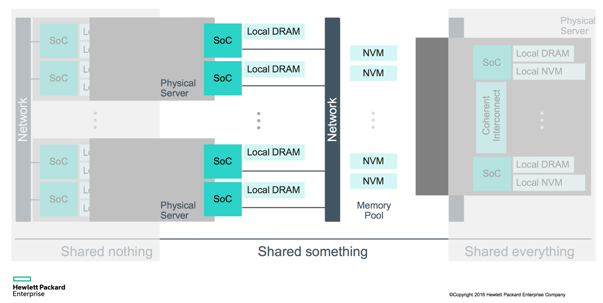
Shared-Something + Resource Disaggregation is Here!

Slide 51
Open Discussion - 2
Will we come back to client-centric models?
As opposed to server-centric/datacenter-driven model today
If yes, why and when?
If not, why not?

Slide 52
Edge Computing + IoT is Here!
Diagram from https://www.openautomationsoftware.com

Slide 53
Next Class…
Read the assigned papers
GFS and MapReduce
Form groups of 3 and fill out https://goo.gl/forms/ajVrsWsd7r81daTx2 tonight
This includes track and paper preference for your group

